Slide 1
GENERAL RULE
Any participant or observer will not be allowed to enter the premises
without an ID card of his/her college
Registrations to all games can be done in advance .
Last date of Registration will be February 26 , 2020
Decision of coordinators and umpires of each game will be final and binding on all participants in any matter. No disputes regarding the results shall be entertained
Each game is a knockout series
Registration for every games are compulsory
Exciting Cash Prizes, Trophies, Medals for winners

Slide 2
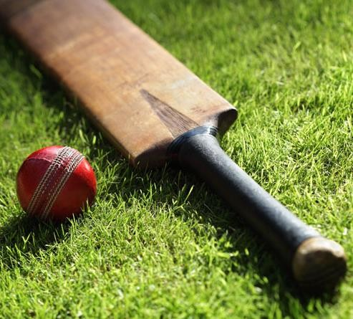
CRICKET
Each team has 11 Active Players and max. 4 Reserve Players.
Inning of 8 over.
Single bowler can bowl maximum 2 over.
Wide ball and overthrow as per normal cricket rules.
Fielding Restrictions will apply for first 2
overs.
LBW is applicable and FREE HIT on NO BALL.
In case of tie, super over is applicable.
Each game will be a Knockout game.
Matches will be played with 4 piece leather ball.

Slide 3
FOOTBALL
Each team has 7 Active Players and max. 3 Substitutes.
Each match will comprise of 2 halves of 15 minutes each.
Rolling Substitutes are allowed.
If any player who receives 2 yellow or red card during the tournament will automatically miss his teams next game.
Each game will be a Knockout game.
If there is a tie, than there will be a penalty shootout of 3 shots each team.

Slide 4
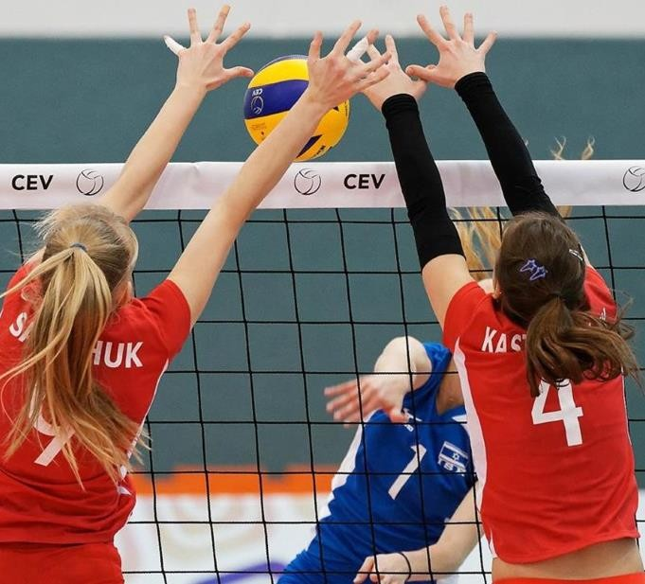
VOLLEYBALL
Team of 6 players, 3 front row, 3 back row
Maximum of three hits per side
Player may not hit the ball twice in succession (A block is not considered a hit)
Ball may be played off the net during a volley
and on a serve
A ball hitting boundary line is in
A ball is out if it hits an antennae, the floor completely outside the court, any of the net or cables outside the antennae, the referee stand or pole, the ceiling above a no playable area
It is legal to contact the ball with any part of a players body
It is illegal to catch, hold, or throw the ball

Slide 5
If two or more players contact the ball at the same time, it is considered one play and either player involved may make the next contact (provided the next contact isn't the teams 4th hit)
A player cannot block or attack a serve from on or inside the 10 foot line.
After the serve, front line players may switch positions at the net
At higher competition, the officiating crew may be made up of two refs, line judges, scorer, and an assistant scorer
Maximum teams permissible-16 (first come first serve basis)
VIOLATIONS
The result of a violation is a point for the opponent.
When serving, stepping on or across the service line as you make contact with the serve.
Failure to serve the ball over the net successfully.
Contacting the ball illegally (lifting, carrying, throwing, etc.)
Touching the net with any part of the body while the ball is in play.

Slide 6
When blocking a ball coming from the opponents court, contacting the ball when reaching over the net is a violation if both:
Your opponent hasn't used 3 contacts and
They have a player there to make a play on the ball
When attacking a ball coming from the opponents court, contacting the ball when reaching over the net is a violation if the ball hasn't yet broken the vertical plane of the net.
Crossing the court centerline with any part of your body. Exception: if it's the hand or foot, the entire hand or entire foot must cross for it to be a violation.
Serving out of order
Back row player blocking (deflecting a ball coming from their opponent), when at the moment of contact the back row player is near the net and has part of his/her body above the top of the net (an illegal block)
Back row player attacking a ball inside the front zone (the area inside the 10 foot line), when at the moment of contact the ball is completely above the net (an illegal attack)

Slide 7
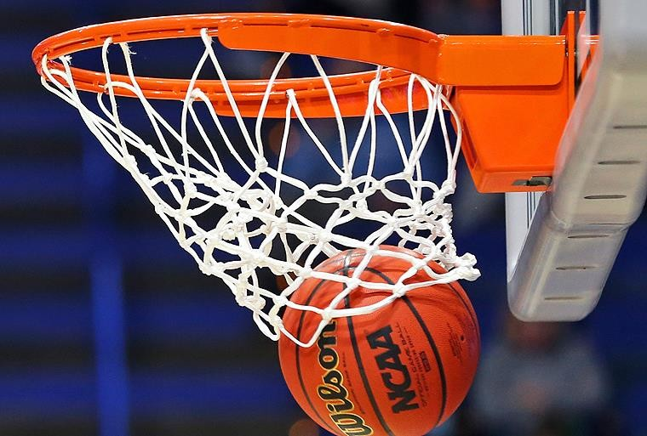
BASKETBALL
A team is made up of 5 players playing on the court and 5 players sitting on the bench that can be used for substitution during the whole period of the game.
A player scores when he manages to throw the ball into the basket, with the ball passing through the basket from above the hoop. Scoring a basket increases the team's score by 3, 2 or one point.
If the player successfully shoots from outside of the 3 points line, the basket is worth 3 points, otherwise it is worth 2 points.
It is also possible to score one point when shooting from the free throw line, after a foul for instance.

Slide 8
VIOLATIONS
It can result from the player taking more than 2 steps without bouncing the ball on the floor. This is called Traveling.
Another example of violation occurs when a player stops dribbling and then starts dribbling again or when he bounces the ball with both hands on the ball. We call this a double Dribble.
A violation is also committed if you twist your hand, when in contact with the ball, beyond the vertical, bringing it under the ball. This is called Carry, as the hand must always remain on the top of the ball.
A foul is an illegal action that can be committed by player from one team against a player from the opposing team. Basketball is generally said to be a non-contact game. If contact occurs beyond what is deemed to be reasonable, or if a player thereby obtains an unfair advantage from it, a foul is committed.
There are two types of fouls. The first are called defensive fouls. They occur when the offensive player is being fouled by the defender. Defenders should not block, push, trip, strike or hold the player in possession of the ball. The second ones are the offensive fouls. For example, a player in offence commits a foul when charging into a stationary defender.

Slide 9
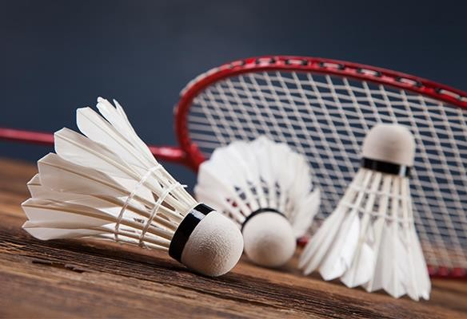
BADMINTON
SCORING SYSTEM
Every time there is a serve - there is a point scored.
The side winning a rally adds a point to its score.
The side winning a game serves first in the next game.
SINGLES
At the beginning of the game (o-o) and when the server's score is even, the server serves from the right service court. When the server's score is odd, the server serves from the left service court.
If the server wins a rally, the server scores a point and then serves again from
the alternate service court.
If the receiver wins a rally, the receiver scores a point and becomes the new server. They serve from the appropriate service court - left if their score is odd, and right if it is even.

Slide 10
DOUBLES
A side has only one ‘service’.
The service passes consecutively to the players as shown in the diagram.
At the beginning of the game and when the score is even, the server serves from the right service court. When it is odd, the server serves from the left court.
If the serving side wins a rally, the serving side scores a point and the same server serves again from the alternate service court.
If the receiving side wins a rally, the receiving side scores a point. The receiving side becomes the new serving side.
The players do not change their respective service courts until they win a point when their side is serving.
If players commit an error in the service court, the error is corrected when the mistake is discovered.
In a doubles match between A & B against C & D. A & B won the toss and decided to serve. A to serve to C. A shall be the initial server while C shall be the initial receiver.

Slide 11
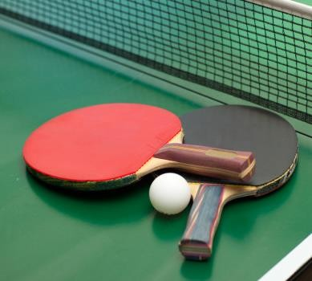
TABLE TENNIS
The server should start with the ball resting freely on an open palm
Project the ball vertically upwards, without
imparting spin, so that it rises at least 16 cm
Strike the ball so that it touches first his/her
court and then, after passing over the net
assembly, touches directly the receiver's court
A set is when one of the players or pairs first
score 11 points. In the event that both players/pairs score 10 points, a set is be won by the first player/pair to gain a 2-point lead. A full match is won when a player or pair wins the best of any odd number of sets (3, 5, 7)

Slide 12
A POINT IS SCORED WHEN
An opponent fails to make a correct service
An opponent fails to make a return
The ball touches any part of an opponent's body
An opponent strikes the ball twice in succession
If an opponent, or anything an opponent wears, touches the playing surface or net during play
If a doubles opponent strikes the ball out of the sequence established by the first server and first receiver
If the ball touches the table surface, it is declared in
If it touches the side of the table, it is declared out
A player is not allowed to strike the ball in volley, unless the opponent's ball leaves the table and I strike the ball in volley behind the table, in which case the point would be given to me

Slide 13
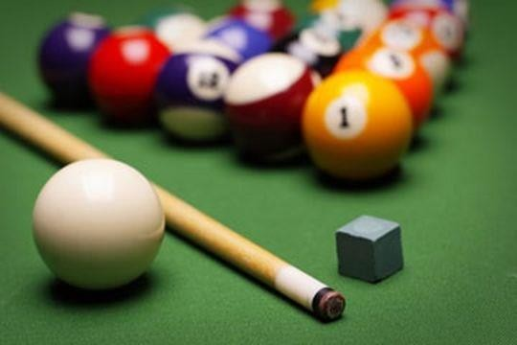
POOL
The player must hit the balls and ensure that four balls hit cushions and that the cue ball doesn't go down a pocket. If the 8-ball is potted on the break, the player is entitled to ask for a re-rack.
The first player to pot an object ball will then have to continue to pot the balls from that category (stripes or solids). The opposition player will have to pot the other group.
A player will continue to make shots until they foul, or fail to pot an object ball. Then it is the turn of the opposing player. Play continues like this for the remainder of the game.
Once all of a player's balls have been potted, they must then sink the 8 ball.
They must first designate which pocket they intend to pot the 8-ball in and then do as stated. Failure to do so will result in the opposition player returning to the table. If the player pots the 8 ball in any other pocket other than the nominated one, they forfeit the game.

Slide 14
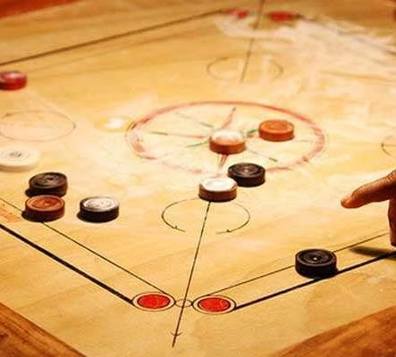
CARROM
For each strike, the player must position the striker within the baseline or on one of the two circles at either end of the baseline
In striking, the player's hand or arm must not cross the diagonal foul lines at either end of the baseline
A player may only pocket and cover the Queen if that player has already pocketed at least one piece of that player's color
Should a player pocket the Queen before being permitted to cover it, the turn continues but the Queen is returned to the center at the end of the turn

Slide 15
FOULS
When a player commits a foul, the turn comes to an end immediately and a
penalty is incurred.
The penalty is that one pocketed piece is returned to the board by the opponent anywhere within the main circle
A Foul is Recorded in the Following Situations:
The striker is pocketed
The striker or any other piece leaves the board
A player contravenes the rules for striking
A player touches any piece in play, other than the striker
Might not touch the oblique arrow line

Slide 16
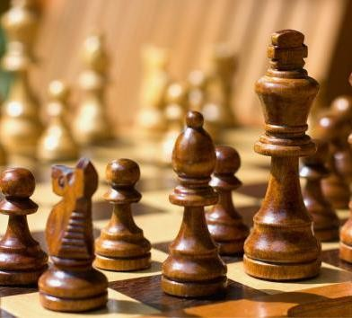
CHESS
The white player makes the first move.
If a player touches one of their own pieces they must move that piece as long as it is a legal move. If a player touches an opponent's piece, they must capture that piece. A player who wishes to touch a piece only to adjust it on the board must first announce what they are doing, usually by saying "adjust“.
Special moves like castling & en-passant are in
the game.
The replacement piece in the special pawn rule is to be placed on the same square in the last row where the pawn was.

Slide 17
Coordinator:
Swapnil :
8126013708
7017003172
Aman:
9971018147

